Slide 1

Amusement Park optimal ratio of fastpass buyers
CSE561: Modeling & Simulation Theory and Application
Final Presentation
Nov 29, 2023
Jisoo Lee, Ying Yu Wu

Slide 2
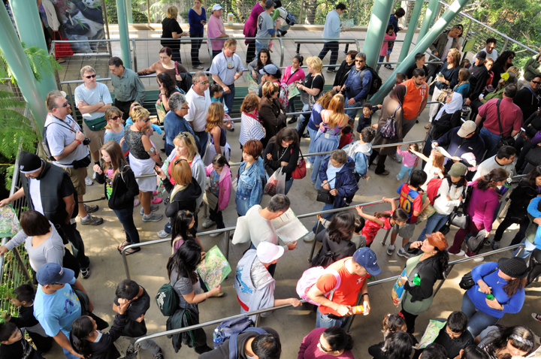


Introduction
Does a Fast Pass at an amusement park really reduce wait time?
The project aims to explore the utility of a fastpass ticket system in an amusement park and to determine the optimal ratio for its effectiveness.
Notes:
https://fantasyworldresort.com/innovative-ways-eliminating-lines-theme-parks/
The project aims to explore the utility of a fastpass ticket system in an amusement park and to determine the optimal ratio for its effectiveness.

Slide 3
Problem description
The project aims to determine the optimal ratio of Fastpass ticket buyers to achieve an appropriate gap in waiting times between the Fastpass line and the normal line in an amusement park. The objective is to strike a balance that ensures efficient utilization of the Fastpass system, enhancing the overall visitor experience. By finding the optimal ratio, the goal is to minimize waiting times for Fastpass users while maintaining reasonable wait times for those in the normal line. This inquiry is crucial to optimizing the effectiveness of the Fastpass ticket system and improving overall park operations.

Slide 4
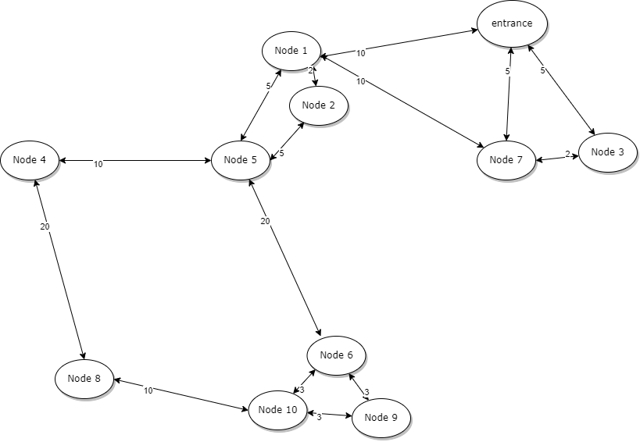
Model formulation
Entrance: Generator
Visitor: Entity
Attractions: Processors

Slide 5
Model formulation
Attraction 1
Transducer 1
Attr1 avg waiting times
start
Generator
Monitor
Attr2 avg waiting times
stop
Attraction 2
Avg waiting time ratio
Transducer 2
.
.
.

Slide 6

Generator & Entity
start
Generator
Visitor group (5-7 people)
stop
. . .
Visitor Example
name: visitor0
status: 1
orderList: [4, 5, 2, 1, 3, 0, 7, 8, 6, 3]
Fast pass:1, normal pass: 0
Don’t ride anything

Slide 7
Attractions
(example)
“run”
Visitor group (5-7 people)
Load list group (7 people)
Attraction 3
(capacity 7)
. . .
in
out
. . .
From generator
To transducers
Normal line
v1 | v2 | v5 | v7 | v14 | v15 | v17
“Passive”
Fast line
v3 | v9
If #people of two lines >= capacity
“Loading”
Load list
v3 | v9 | v1 | v2 | v5 | v7 | v14
Notes:
Input and output? Phase = passive, loading, run

Slide 8
Transducers
(example)
(from Generator) Arriv
Transducer 3
T (to attractions, transducers)
(from other Transducers) Other
(from corresponding Attraction) Solved
Waiting time (to monitor)
Waiting time
Duration
Distance(time)
The arrival time of the visitor
: Arriv
The boarding time of the visitor
: Solved
The leaving time of the visitor
: T,Waiting time
Notes:
Arriv. Other. Solver / T. waiting time

Slide 9
Transducers
Attraction 1
Attraction 2
visitor
Transducer 1
visitor
Transducer 2
other

Slide 10
Monitor
Waiting time i: ith attraction’s average waiting time of fast line(F) and normal line(N)
Ratio:
average waiting time of fast lines average waiting time of normal lines
  Large ratio: small gap
  Small ratio: large gap
Monitor
Waiting time 1 (F)
Waiting time 1 (N)
Waiting time 2 (F)
.
.
.
Waiting time N (N)
Ratio

Slide 11
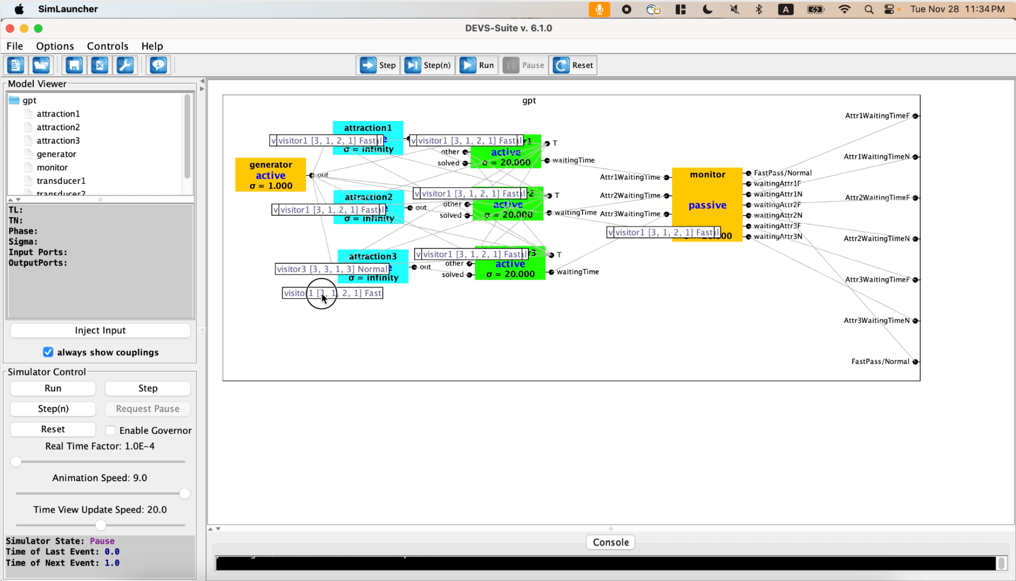
Demo video

Slide 12
Experimental setups (DEVS v6.1.0)
Variables | Values
Visitor group size (generate every minute) | 5-10
Number of attractions | 3
Number of experiments | 3(ratio) X 3(attempt)
Capacity | Attraction 1 | Attraction 2 | Attraction 3
 | 10 | 7 | 12
Duration (minute) | Attraction 1 | Attraction 2 | Attraction 3
 | 4 | 3 | 5
Operating time (minute) | 20

Slide 13
Experiment results
 |  | 1st |  | 2st |  | 3rd
Fastpass ticket ratio | Attractions | Fast line waiting time(min) | Normal line waiting time(min) | Fast line waiting time(min) | Normal line waiting time(min) | Fast line waiting time(min) | Normal line waiting time(min)
0.2 | 1 | 1.4 | 2.091 | 1.182 | 2.000 | 0.500 | 1.811
 | 2 | 1.091 | 1.395 | 1.083 | 2.000 | 0.833 | 1.757
 | 3 | 1.00 | 2.528 | 2.100 | 2.889 | 2.200 | 1.690
Notes:
3 different fastpass ticket ratio
Show avg waiting time in fast line/normal line at each attraction
Show overall avg waiting time difference in the entire amusement park

Slide 14
Experiment results
 |  | 1st |  | 2st |  | 3rd
Fastpass ticket ratio | Attractions | Fast line waiting time(min) | Normal line waiting time(min) | Fast line waiting time(min) | Normal line waiting time(min) | Fast line waiting time(min) | Normal line waiting time(min)
0.5 | 1 | 1.357 | 2.583 | 1.353 | 3.077 | 1.120 | 2.059
 | 2 | 0.875 | 1.619 | 1.211 | 1.947 | 1.143 | 2.941
 | 3 | 0.800 | 3.235 | 1.556 | 3.167 | 1.333 | 4.000
Notes:
3 different fastpass ticket ratio
Show avg waiting time in fast line/normal line at each attraction
Show overall avg waiting time difference in the entire amusement park

Slide 15
Experiment results
 |  | 1st |  | 2st |  | 3rd
Fastpass ticket ratio | Attractions | Fast line waiting time(min) | Normal line waiting time(min) | Fast line waiting time(min) | Normal line waiting time(min) | Fast line waiting time(min) | Normal line waiting time(min)
0.7 | 1 | 1.429 | 3.714 | 1.519 | 7.000 | 1.125 | 3.615
 | 2 | 0.667 | 2.500 | 1.057 | 2.667 | 0.828 | 3.500
 | 3 | 2.000 | 8.000 | 2.118 | 5.000 | 2.087 | 9.000
Notes:
3 different fastpass ticket ratio
Show avg waiting time in fast line/normal line at each attraction
Show overall avg waiting time difference in the entire amusement park

Slide 16
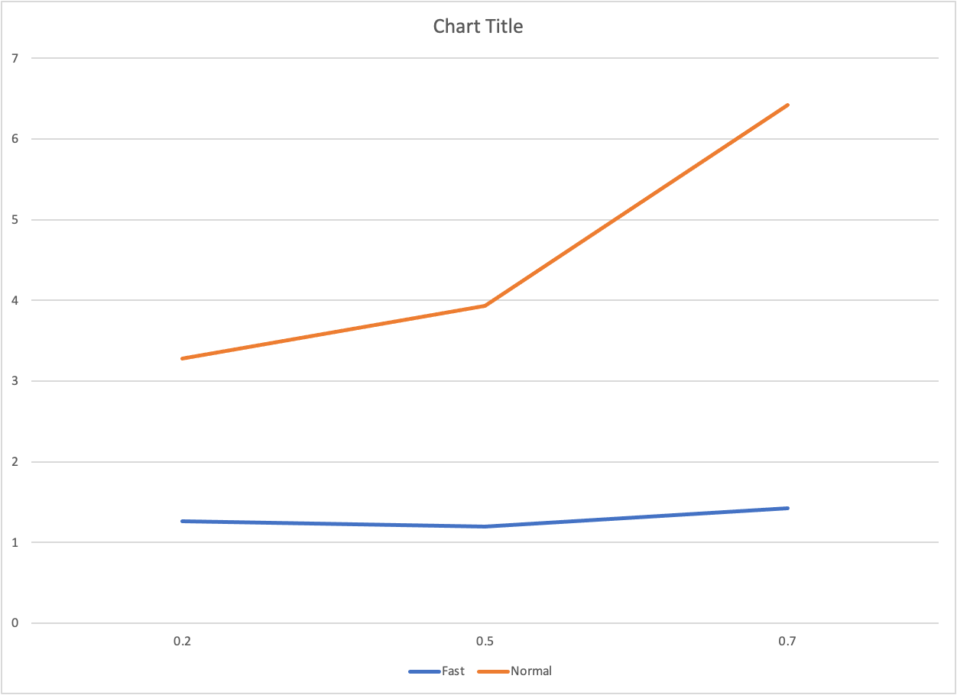
Analysis
Waiting time
(min)
Fastpass ticket ratio

Slide 17
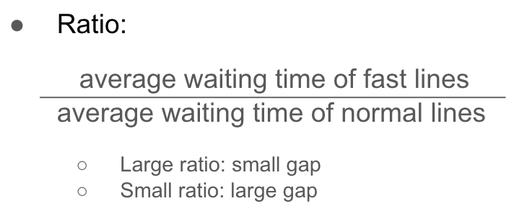
Experiments Results
Fastpass ticket ratio | Ratio (1st) | Ratio (2nd) | Ratio (3rd)
0.2 | 0.616 | 0.620 | 0.684
0.5 | 0.407 | 0.518 | 0.422
0.7 | 0.3 | 0.346 | 0.26

Slide 18
Conclusion
Considering our goal is to reduce waiting times for Fastpass users while maintaining reasonable wait times for those in the normal line, as reflected in the chart above, increasing the Fastpass ticket ratio to 70% appears impractical since it significantly extends the waiting times for people in the normal line. We believe that setting the ticket ratio between 20% and 50% is ideal, according to our considerations.

Slide 19
Thank You
Q&A

